Slide 1

VR TRAVELLER (A Virtual History Simulation)
Group Members
Abdul Wasey (19P-0113)
Ammaar Ahmed Khan (19P-0016)
Mohammad Junaid (19P-0025)
Project Supervisor
Mr. Zeshan Khan

Slide 2
Table of Content
Execution Plan
Main Objective of FYP-2
Project Progress
System Diagram
Gantt Chart

Slide 3
Execution Plan

Slide 4
Execution Plan
FYP I
Gathering Data
Asset Creation
Historical Data Collection
Environment Prototype
FYP II
Asset Creation
Interactive Menu
Historical Relevance to Architecture
Making NPC's Interactable
Oculus Integration

Slide 5
Main Objective of FYP-2

Slide 6
Main Objective of FYP-2
Multiple Timeline
Viking
Gandhara
VR Historical Simulation
XR Interactable
Player Spawner
UI Screen For Simulation
Main Menu Options ()

Slide 7
Project Progress

Slide 8
Goals Achieved
UI Screen for simulations
Oculus Integration
Multiple Simulations
Playable file
Character rigging

Slide 9
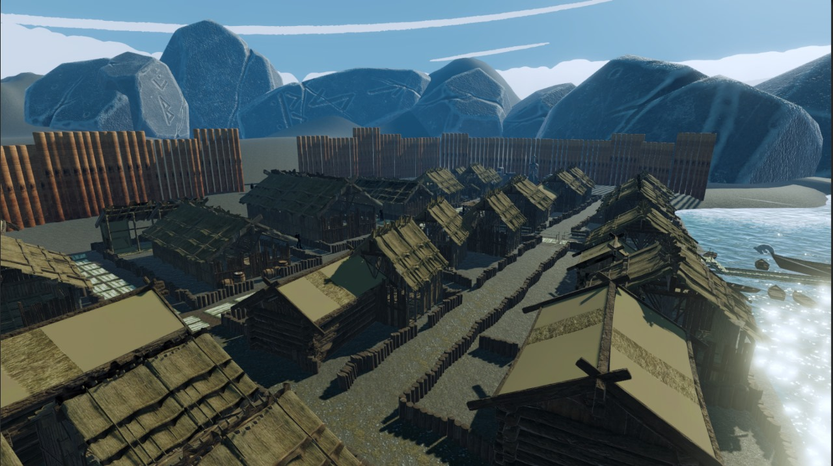
Demo / Testing Simulation Version 4

Slide 10
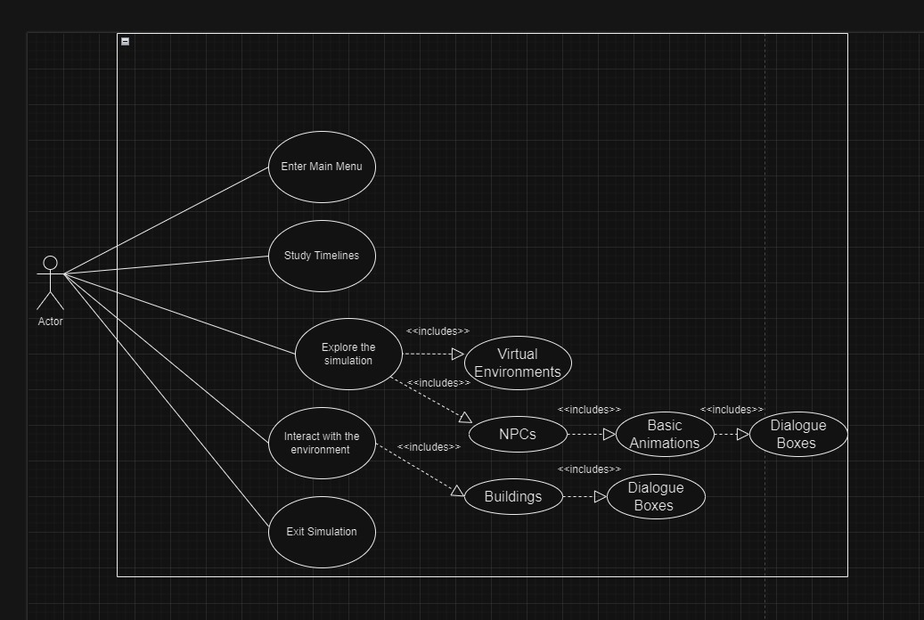
Use Case Diagram

Slide 11
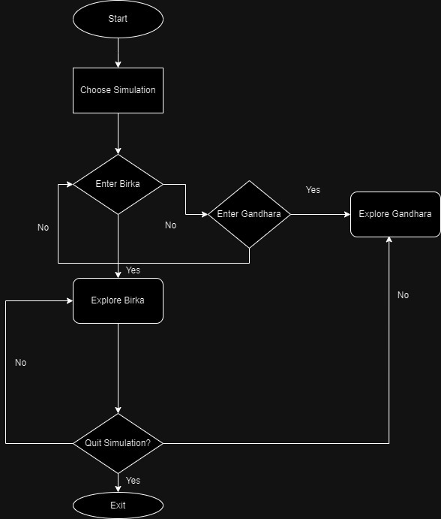
Flow Chart Diagram

Slide 12
Project Versioning
https://drive.google.com/file/d/1LJ4ordX7UUGVs3VjBDseqCZmoQgBWgdc/view?usp=sharing
https://drive.google.com/file/d/18p3KQf7RfeyKBaEhjjkZLVn3Y7npbmwH/view?usp=drivesdk

Slide 13
Timeline

Slide 14
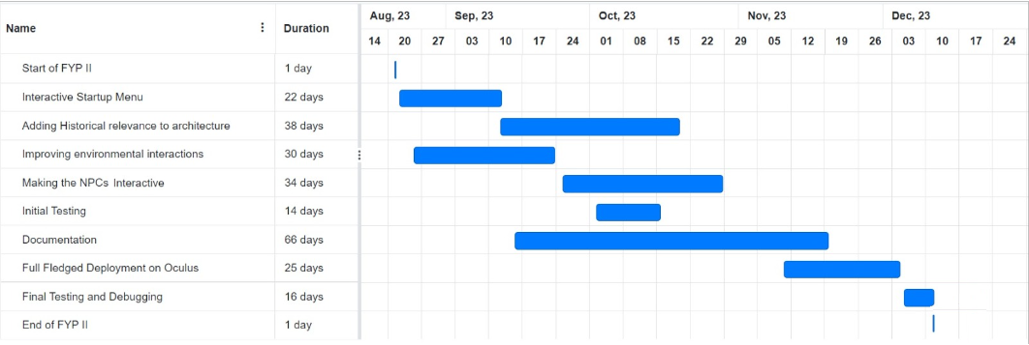
FYP-2 Gantt Chart

Slide 15
Thank you for listening !
Any Questions?

